Slide 1
“You Are Still Good” Application Bible Study

Slide 2
Pre-work and Best Practices
Read “You Are Still Good” by La’Wana Harris and complete the Insights & Reflections sections in the book.
This discussion guide is designed for maximum interaction and participation from each student.
Teachers or session leaders should try to lead with the 80/20 rule. (Students talk 80% of the class and leaders talk 20% of the class)
Encourage open and honest dialogue amongst the class so that everyone can deal with where they are relative to any tragic or crisis events in their lives.

Slide 3
Objectives
Review and discuss the main themes of the book.
God is still good regardless of life’s circumstances.
Your faith will be tested.
Stand firm on God’s word during times of crisis and tragedy.
Share your testimony with others who may go through similar situations.
Commit to apply one or two key learnings.
Pair up with an accountability partner to encourage and support each other.

Slide 4
What does “God is good” mean to you?
What does God’s word say about His goodness?
Luke 18:19 And Jesus said to him, "Why do you call Me good? No one is good except God alone.
Psalm 106:1 Praise the LORD! Oh give thanks to the LORD, for He is good; For His lovingkindness is everlasting.
How has God shown his goodness to you?
Psalm 23:6 Surely goodness and mercy shall follow me all the days of my life, and I shall dwell in the house of the LORD forever.

Slide 5
Promptings of the Holy Spirit
Have you ever felt a gentle nudge to do something out of the blue?
Luke 4:1 Jesus, full of the Holy Spirit, left the Jordan and was led by the Spirit into the wilderness,
Have you ever felt a strong urge to do something with urgency that seems to come out of nowhere?
Acts 8:29 Then the Spirit said to Philip, "Go up and join this chariot.“
What do you do when the Holy Spirit urges you to do something that defies human logic and reasoning?
Romans 8:14 For those who are led by the Spirit of God are the children of God.

Slide 6
What is truly most important to you?
How do you keep things in perspective when life is hectic?
Psalm 61:2 From the end of the earth will I cry unto thee, when my heart is overwhelmed: lead me to the rock that is higher than I.
What are your ideal priorities?
Matthew 6:33 Seek the Kingdom of God above all else, and live righteously, and he will give you everything you need.
Is how you spend your time and your resources aligned with your priorities?
Matthew 6:21 Wherever your treasure is, there the desires of your heart will also be.
If not, what adjustments do you need to make to keep God first and focus on your priorities?
Romans 12:2 Do not be conformed to this world,but be transformed by the renewal of your mind, that by testing you may discern what is the will of God, what is good and acceptable and perfect.

Slide 7
Have you ever felt that God was speaking to you?
What is your litmus test to confirm if God has spoken to you?
John 10:27 My sheep listen to my voice; I know them, and they follow me.
Ask yourself these three questions.
Does what you heard align with the word of God?
Will it bring glory to God?
Do you have a sense of peace about it?

Slide 8
The Power of applying God’s word to your life
How has God’s word impacted your life in times of crisis?
Psalm 119:105 Your word is a lamp for my feet, a light on my path.
What verses speak to where you are currently?

Slide 9
Tough Questions
Why do bad things happen to good people?
Romans 8:18 For I consider that the sufferings of this present time are not worth comparing with the glory that is to be revealed to us.
Is God still good when tragedy or death happens?
Jeremiah 29:11 For I know the plans I have for you," declares the LORD, "plans to prosper you and not to harm you, plans to give you hope and a future.

Slide 10
Only God gets the glory.
What are some of the experiences that you have had with God that you can draw strength from in times of crisis?
1 Samuel 17:37 And David said, "The LORD who delivered me from the paw of the lion and from the paw of the bear, He will deliver me from the hand of this Philistine." And Saul said to David, "Go, and may the LORD be with you.
What are some of the ways that God has worked in your life in which no one can get the glory but Him?
Romans 11:36 For everything comes from him and exists by his power and is intended for his glory. All glory to him forever! Amen.

Slide 11
Setting the atmosphere for faith
How do you create an environment where your faith is revived during trials and challenges?
Which songs stir your spirit to press on in the faith?

Slide 12
What does “God is Still Good” mean to you?
What has happened in your life that challenged your faith or your thinking about God’s goodness?
How can you share the goodness of God with others?

Slide 13
The Shunamite Woman
The Shunamite woman responded, “All is well” before she knew that her son would live. She kept her faith in God regardless of the trial she was enduring at the moment. She knew that God was with her and that everything would be alright.
2 Kings 4:26 Run at once to meet her and say to her, ‘Is all well with you? Is all well with your husband? Is all well with the child?’” And she answered, “All is well.

Slide 14
Your crisis is a set up for God to get the glory.

Slide 15
Points of Reflection
Things that seem vitally important can become completely insignificant in an instant.
You can have peace in the midst of tragedy.
Your faith will be tested.
Sometimes there is a process that follows revelation.
Accepting Jesus Christ is the best decision you can ever make.
You are never alone.

Slide 16
What are the one or two things that you will take forward with you in your walk with the Lord?
Commit to one or two areas from your reflections to take forward with you.
Pair up with an accountability partner to help encourage each other and hold each other accountable.
Share your commitment with your accountability partner.
Pray for each other and support each other in that specific area of need.
Hold each other accountable as you move forward in your walk with the Lord.
Share your testimony of overcoming tragedy or crisis as the Lord leads you to empower others.

Slide 17
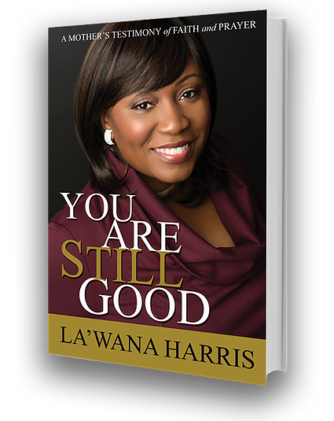
"You Are Still Good” by La’Wana Harris
Thank You!
Praise the LORD! Oh give thanks to the LORD, for He is good; For His lovingkindness is everlasting. Psalm 106:1

